Slide 1

ANALYSIS ON SINGAPORE’S PUBLIC TRANSPORT
Denzel See (2222840)

Slide 2
DATASETS
https://www.kaggle.com/datasets/vancharmlab/singapore-bus-data
https://data.gov.sg/dataset/public-transport-utilisation-average-public-transport-ridership
https://data.gov.sg/dataset/fare-structure-mrts-and-lrts
https://data.gov.sg/dataset/fare-structure-for-trunk-bus-services
https://data.gov.sg/dataset/public-transport-utilisation-average-trip-distance

Slide 3
BUS DATASETS
Bus routes
Bus services
Bus stops
This dataset contains:
Service no.
Bus operator
Bus direction
Stop sequence
Distance
Weekday First & Last Bus no.
Saturday & Sunday First & Last Bus no.
This dataset contains:
Service no.
Bus operator
Bus direction
Bus category
Bus origin bus stop code
Bus destination bus stop code
Peak & Off-peak timing
This dataset contains:
Bus stop code
Road name
Description
Latitude
Longitude

Slide 4
PUBLIC TRANSPORT DATASET
Average Ridership
Average Trip Distance
This dataset contains:
Year
Type of transport
Average ridership
This dataset contains:
Year
Type of transport
Average trip distance

Slide 5
PUBLIC TRANSPORT DATASET
MRT & LRT fare
Trunk Bus fare
This dataset contains:
Distance
Type of fare ( Adult, Child etc.)
Applicable Timing
Fare per ride
This dataset contains:
Distance
Type of fare ( Adult, Child etc.)
Payment type
Bus fare
Note: I used trunk bus fare as trunk buses is the most common type judging from the histogram

Slide 6
OBJECTIVE 1
FIND OUT THE DIFFERENCE BETWEEN THE FOUR BUS OPERATORS

Slide 7
GRAPH 1
DATA WRANGLING
FILTERING OUTLIERS
Filtered the four operators into their own separate variable
Find out the interquartile range and filtered outliers by filtering any data above the upper fence
Concatenate all the variables back into one dataset
Dropped all unwanted columns using the .drop function.

Slide 8
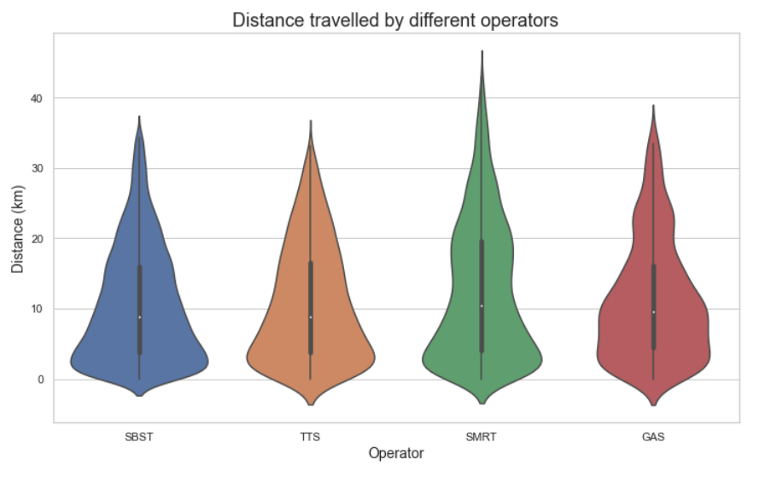
INSIGHTS
SMRT tend to travel further than the other operators
GAS has slightly more buses that travel in moderate distance
TTS and SBST has about the same distribution in travelling distance
SBST has the greatest frequency in buses travelling short distance

Slide 9
GRAPH 2
DATA WRANGLING
Filtered out one direction
Filtered the operators into their own variables
Dropped all unwanted columns using the .drop function.
Plot 4 histograms

Slide 10
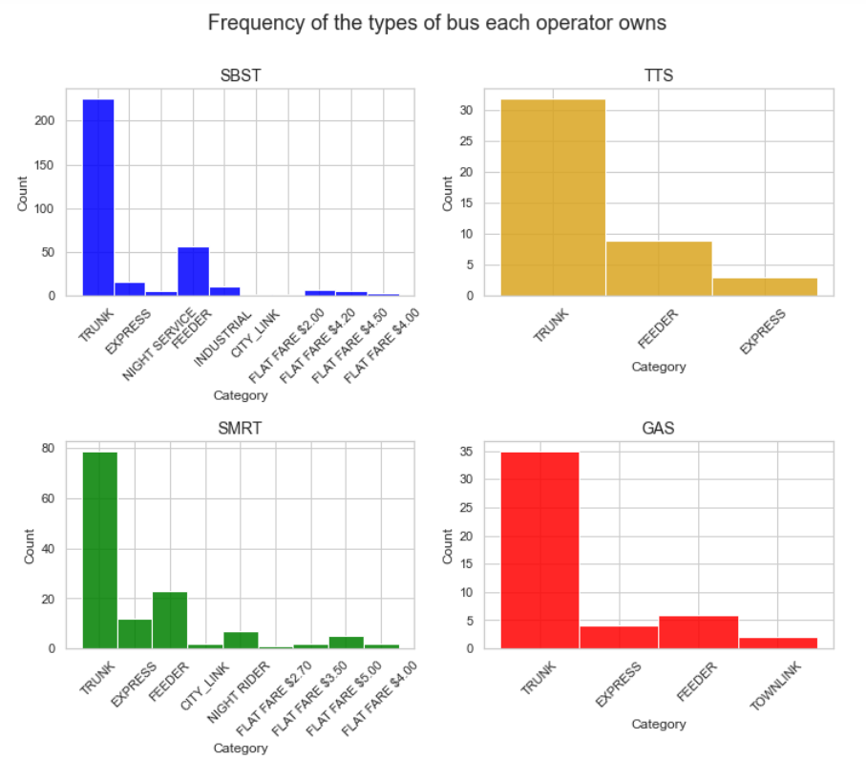
INSIGHTS
SBST has the greatest amount of bus types and bus
GAS has a special bus type Townlink which no other operator have
SMRT also have a lot of bus types but do not control as many buses
TTS only have 3 bus types

Slide 11
GRAPH 3
DATA WRANGLING
Filtered out one direction
Dropped all unwanted columns using the .drop function.
Used pd.merge, merging on bus stop code, linking the two datasets together
This links the operator to the bus stop to see the distribution of operator in Singapore

Slide 12
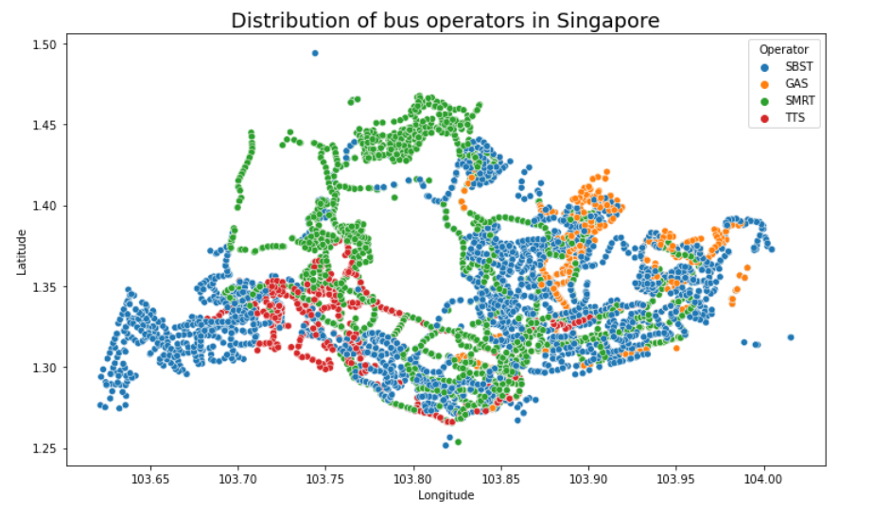
INSIGHTS
SBST have the greatest distribution
GAS have very little stops and is only present in the east
SMRT also have one of the largest distribution but mainly is present from north to south
TTS is similar to GAS , being mostly present in the west with similar number of stops

Slide 13
OBJECTIVE 2
Compare the different types of public transport in Singapore

Slide 14
GRAPH 1
DATA WRANGLING
Cut down the number of years displayed using the isin function
Used the 2 years per 5 years apart e.g.(1995,1996, 2000,2001)

Slide 15
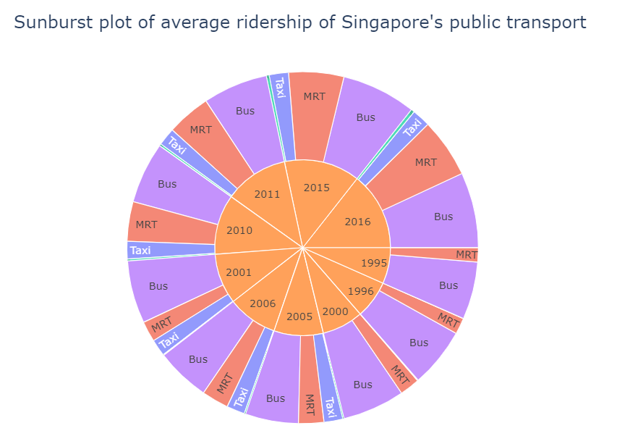
INSIGHTS
Bus always had a larger ridership than MRT but now its almost the same as MRT
LRT was introduced between 1996 to 2000 but does not show much growth compared to other transports
Taxi data only started being collected between 2000 to 2005
MRT ridership shows the quickest growth

Slide 16
GRAPH 2
DATA WRANGLING
Filtered out all columns except for Adult using isin and Boolean indexing
Renamed columns for better presentation
Filtered applicable timings into their own separate variables
Made a new data frame taking values from two separate dataset

Slide 17
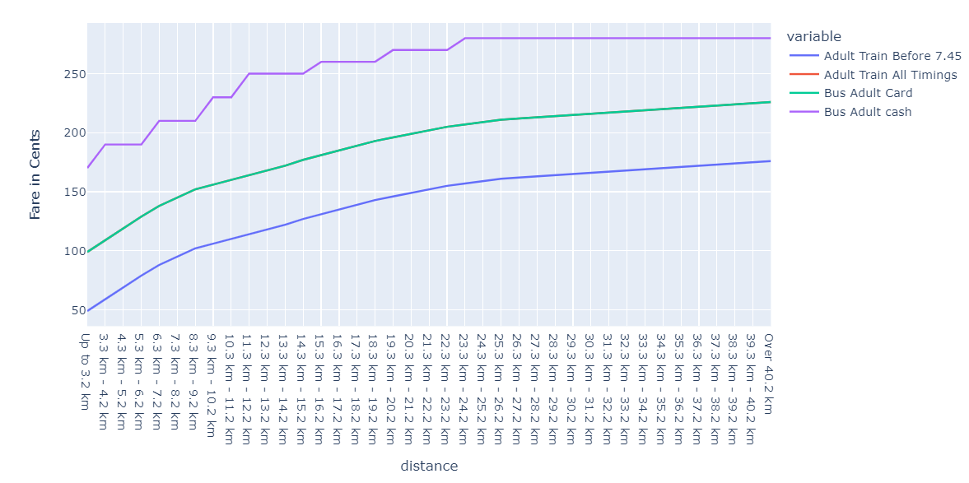
INSIGHTS
When using card for payment, MRT and Bus have the same increments per increase in distance
Bus payment by card has the exactly same price and increment as MRT as both lines overlap
Adult Train before 7:45 have the same increment but have a cheaper price
Only bus payment with cash has a different increment, having a staircase pattern and is much more expensive.

Slide 18
GRAPH 3
DATA WRANGLING
Filtered the years by using .loc
Renamed the column to mode so that the two datasets can merge
Used pd.merge to merge the datasets on year and mode
Then filtered out the different mode of transport into their separate own variable

Slide 19
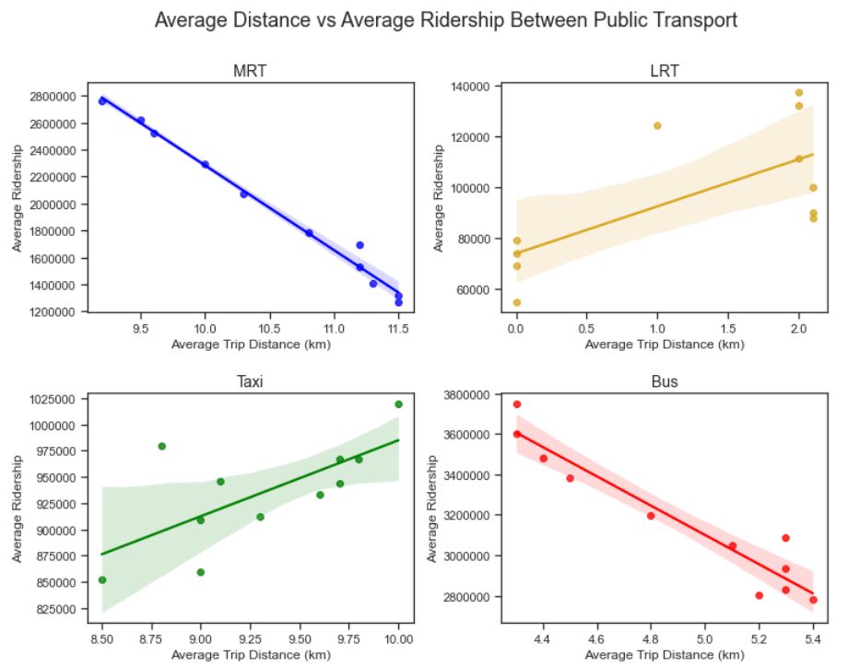
INSIGHTS
Less people would take MRT to travel further distance
LRT is special as most people would either go far or short distance
Bus is similar to MRT however the distance traveled is much shorter
Most people takes taxi to go a long distance

Slide 20
Suggestion
The price for MRT and Bus should have a lower increase in price after 10 km since lesser people ride the MRT for longer distance
Government should focus on expand the LRT since it is supposed to be the “in-between” of the MRT and the Bus but has not seen significant growth as compared to other public transports

